Slide 1
OpenGL
Base engine overview
Advanced Graphics Programming

Slide 2
Platform

Slide 3
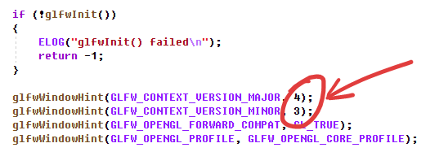
OpenGL version (platform.cpp)
We will use OpenGL 4.3 Core profile.
We don’t use the compatibility profile to avoid calling deprecated OpenGL functions.
There are newer OpenGL versions with more and more function calls. You can increase the version it if at some you require some newer functionality.
However, all the contents given in this subject can be implemented using 4.3 with no problem.

Slide 4
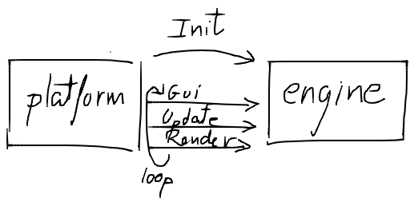
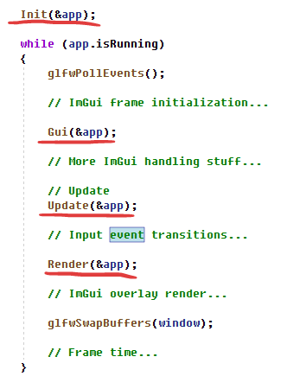
Application life cycle (platform.cpp)
We implement these functions in engine.cpp.
These are the typical Application class functions. Just another way of doing it.
Feel free to modularize the code if you feel more comfortable… but we will not be implementing more modules than the render module.
What are they for?
Init: to initialize one-time-load resources
Gui: to program our imgui controls
Update: to implement shortcuts and camera movement
Render: real-time opengl rendering code

Slide 5
Platform interface

Slide 6
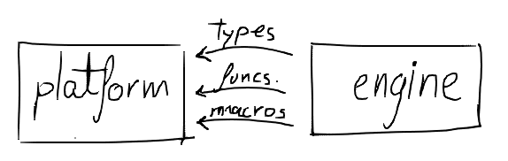
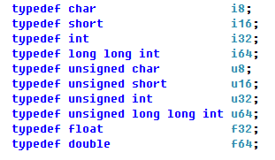
Platform utils (platform.h)
Sized types

Slide 7
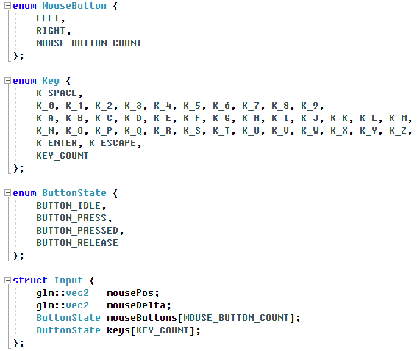
Platform utils (platform.h)
Input types

Slide 8
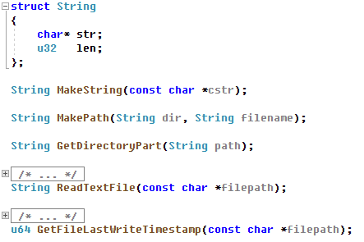
Platform utils (platform.h)
Strings / File functions

Slide 9
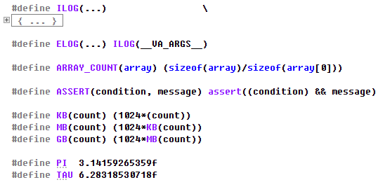
Platform utils (platform.h)
Macros

Slide 10
Engine types

Slide 11
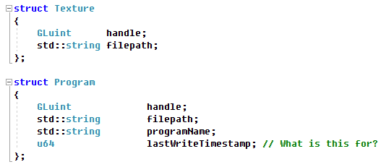
Engine types (engine.h)

Slide 12
Engine types (engine.h)

Slide 13
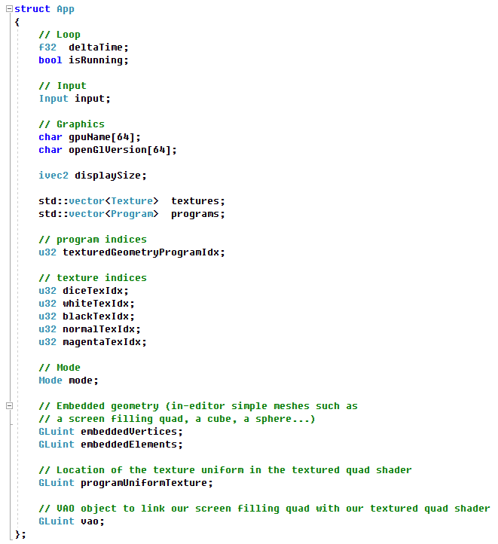
Engine types
(engine.h)

Slide 14
TODO:
Retrieve OpenGL information

Slide 15
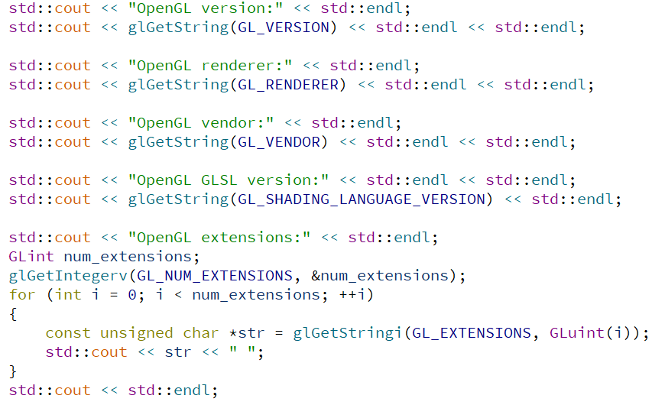
TODO: Retrieve OpenGL information
With Dear ImGui, create a new window showing information about the OpenGL context.
You can retrieve the information only once in the initialization function.
Instead of printing this information as in the image, store it into some OpenGLInfo struct within our application and show it on a dialog when a certain button or menu action is pressed.

Slide 16

TODO:
Let’s paint a textured quad

Slide 17
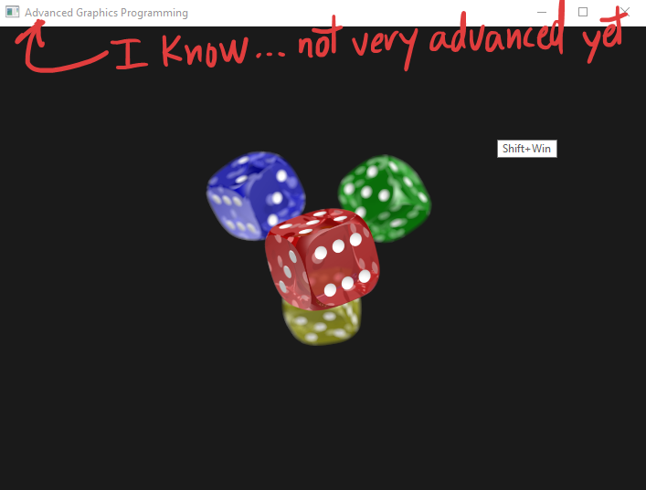
TODO: Let’s paint a textured quad
To paint this quad we will need to prepare some OpenGL objects:
An VBO or vertex buffer object (an array in the GPU with the actual vertex data: 3D and texture coords)
An EBO or element buffer object (an array in the GPU with the indices in the order they should be drawn)
A VAO or vertex array object (an object that links the vertex buffer with the program)
A shader program (the code that we will install in the GPU, that will position and paint the quad)
A texture.

Slide 18
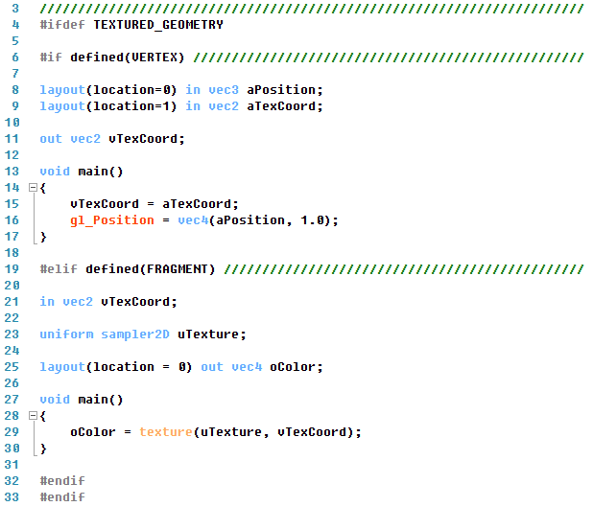
TODO: Let’s paint a textured quad (GLSL code)

Slide 19
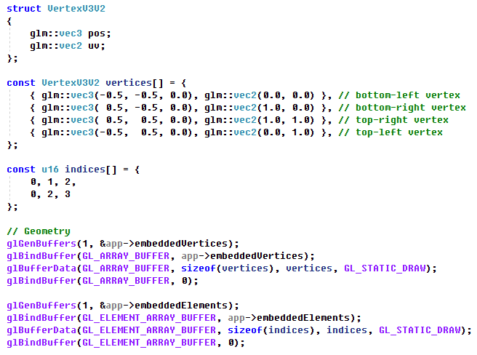
TODO: Let’s paint a textured quad (VBO and EBO initialization)
Vertex shader (to have context)

Slide 20
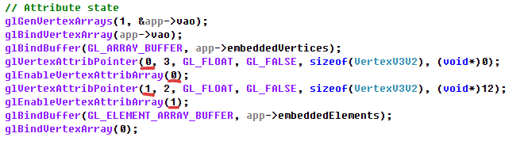
TODO: Let’s paint a textured quad (VAO initialization)
Vertex shader (to have context)
Between glBindVertexArray(handle) and glBindVertexArray(0) VAOs record the state described by the function calls in the middle:
Enabled vertex attributes
Pointers into the buffers for those enabled vertex attributes
Bound element array buffers (indices)

Slide 21

TODO: Let’s paint a textured quad (Program initialization)

Slide 22

TODO: Let’s paint a textured quad (Texture initialization)

Slide 23
Now really…
let’s paint a textured quad!

Slide 24
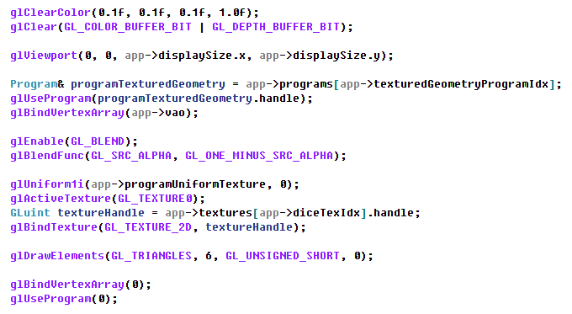
TODO: Let’s paint a textured quad

Slide 25
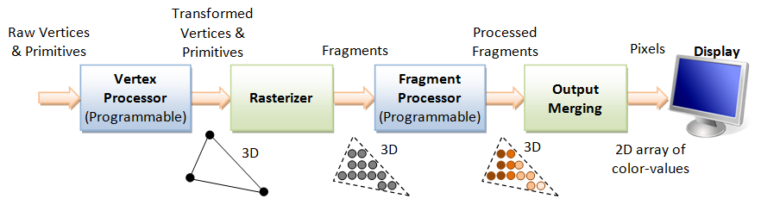
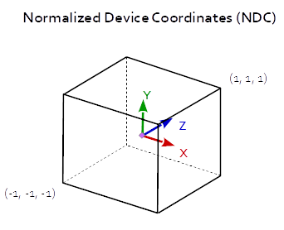
TODO: Let’s paint a textured quad
When we perform the rendering call, the following pipeline will execute in the GPU:

Slide 26

TODO: Let’s paint a textured quad

Slide 27
TODO: Let’s paint a textured quad

Slide 28
TODO: Let’s paint a textured quad

Slide 29
TODO: Let’s paint a textured quad

Slide 30

TODO: Let’s paint a textured quad

Slide 31

TODO: Let’s paint a textured quad

Slide 32
TODO: Let’s paint a textured quad

Slide 33
TODO: Let’s paint a textured quad

Slide 34


